Slide 1
PowerPoint can be found at
https://allceus.com/IBH

Slide 2
Transdiagnostic (Holistic) Approaches to the Treatment of Co-Occurring Disorders
Presented by: Dr. Dawn-Elise Snipes
Executive Director, AllCEUs.com Counselor Education

Slide 3
Objectives
Define the transdiagnostic and transactional theories
Explain the connection between addiction and mood disorders and
Stress
Nutritional Imbalances
Sleep and circadian rhythm dysregulation
Identify transdiagnostic interventions that will aid in addressing mood and addictive disorders and physical health issues

Slide 4
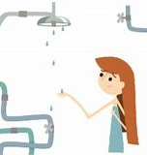
Problem: Not Enough Water Cause: Leak or blockage in the system Fix: Turn up the water pressure Find the leak and repair it

Slide 5
Transdiagnostic & Transactional Approaches
Transdiagnostic Model (Finding the leak)
Asserts that many symptoms are common to many disorders such as
Changes in sleeping patterns
Changes in eating patterns
Irritability
Fatigue
We need to address what is causing the symptom
If you have a 48 year old female client who presents with
6 weeks of clean time (>10 years use), apathy, anhedonia, fatigue, hypersomnia, lack of appetite but clinically obese, what might be the diagnosis?
PAWS, depression, sex hormone imbalances, thyroid hormone imbalances, apnea, HPA-Axis dysfunction, nutritional deficits, sleep and circadian rhythm dysfunction

Slide 6
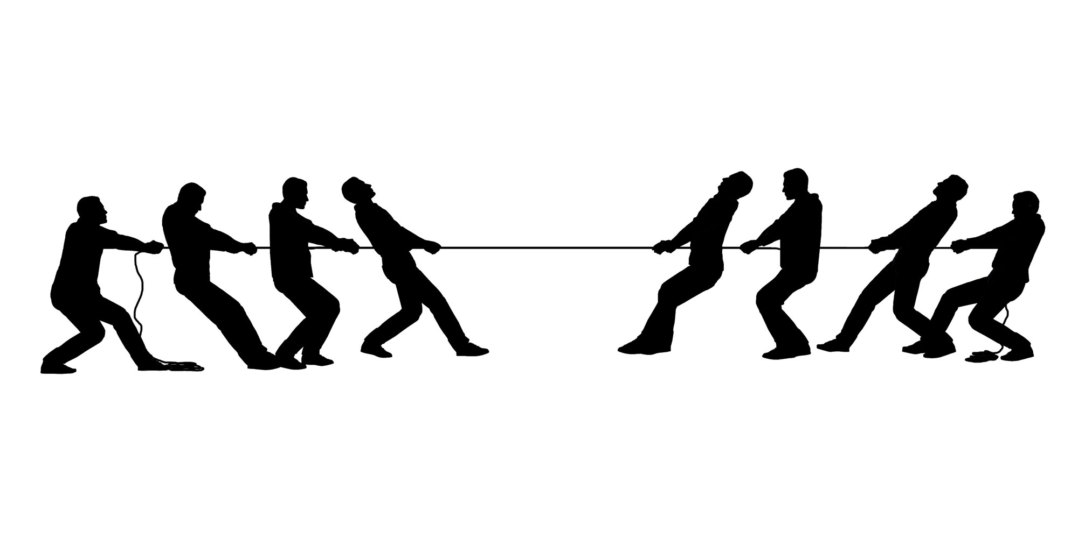
Transdiagnostic & Transactional Approaches
Transactional Model
Asserts that there is a reciprocal interaction between everything.
Transactions can be positive or negative
Nutrition
Sleep
Psychopharmacology
Mindfulness

Slide 7
Common Co-Occurring Issues
Chronic Stress
Mood Disorders
Autoimmune Issues
Chronic Pain
ADHD
Post Acute Withdrawal Syndrome
How do each of these impact people’s ability to achieve full and sustained recovery?

Slide 8
HPA Axis “Threat Response System”
Excess stress depletes natural dopamine stores and creates a ripple effect on endorphins (pain and pleasure)
Hypothalamic-Pituitary-Adrenal (HPA) axis dysregulation in response to chronic stress
Low serotonin leads to less inhibition of aggression, anhedonia
High serotonin leads to decreased appetite, less need for sleep, increased agitation (Anger/agitation/anxiety)
Adrenaline and noradrenaline turn on, leading to increased “hyperfocus” and attention
Combined these increase cardiac output (“Anxiety”)
Dopamine sustains the needed energy level and prompts an increase in endogenous opioids which subdue the pain being experienced

Slide 9
HPA Axis
Continued stress → Hypocortisolism
Dopamine decreases: Fatigue & anhedonia, impulsivity/self-harm
Higher levels of endogenous opioids (but less effective): Numbing, blunting, depersonalization, risk of addictive behaviors
Symptoms of dysregulation and depression

Slide 10
Transdiagnostic Issues
Stress causes people to use a lot of dopamine
Dopamine dysregulation is thought to play a role in
Mood Disorders
Addiction
ADHD
Chronic Pain
Autoimmune Issues

Slide 11
Transdiagnostic Issues
Cortisol (Stress hormone)
Is necessary for motivation but in excess…
Increases estrogen and reduces testosterone (reduced libido)
Dysregulates serotonin and dopamine (and melatonin, ghrelin, leptin)
Sleep
Mood
Appetite
Pain Tolerance
Causes chronic inflammation which is strongly correlated with pain and depression

Slide 12
Trauma, Stress and the HPA-Axis
Trauma and even chronic or acute stress causes HPA-Axis dysregulation and can lead to hypercortisolism (Depressive symptoms and dysregulation)

Slide 13
Marinara
Oregano– Bitter, spicy
Basil--Sweet
Garlic—Balances basil
Marjoram—Sweet, minty
Parsley—Flavor enhancer
Salt—Balances sugar
Sugar—Eliminates bitter

Slide 14
Stress and Co-Occurring Issues
Addictions
Numb stress
Self medicate mood issues related to stress, systemic dysfunction or ADHD
Self medicate pain issues (exacerbated by stress)
Anxiety & Depression
Systemic disruption due to addictions including PAWS
HPA Axis dysregulation due to stress
Lifestyle factors adding stress to the body

Slide 15
Stress Reduction: What Causes Stress?
What we usually address
Cognitive
Problem Solving
Dialectics/Living in the And
Learned Optimism
Inner Critic
Interpersonal
Communication
Boundaries and Healthy Relationships
Attachment

Slide 16
Stress Reduction
What we usually address
Environmental
Noise
Light
Smell
Ergonomics
Safety (Emotional and Physical)

Slide 17
What else???
Helping the body machine get what it needs to function more efficiently can assist in addressing a myriad of factors contributing to addiction, mood disorders, chronic pain and more…

Slide 18
Sleep (HALT)
Effects of sleep deprivation
Irritability
Impulsivity
Difficulty concentrating
Depression and anxiety
Addiction
Sleep deprivation is a potential detrimental factor to the extinction process of drug cues.
Sleep interventions can bidirectionally regulate cocaine craving and seeking after withdrawal
Sleep deprivation is a significant risk factor for relapse
Eating disturbances
Reduction in dopamine and increase in serotonin
Improve sleep hygiene

Slide 19
Bright Light
Bright light increases serotonin and helps reset circadian rhythms
Can be helpful in the treatment of
Depression
Addiction
Bright light therapy

Slide 20
Nutrition (HALT)
Nutrition support therapy has been identified as a potential target for addressing
Addiction
Mood disorders: Twelve Antidepressant Nutrients relate to the prevention and treatment of depressive disorders: Folate, iron, long-chain omega-3 fatty acids (EPA and DHA), magnesium, potassium, selenium, thiamine, vitamin A, vitamin B6, vitamin B12, vitamin C, and zinc
The gut microbiome plays a facilitating role between stress response, inflammation, and depression, and anxiety.
Addressing gut health will facilitate improvement in mood, sleep and pain.

Slide 21
Exercise
Moderate intensity exercise for ~30 minutes can be effective in the treatment of addiction
During drug use initiation and withdrawal, effectiveness is related to its ability to increase dopamine. Once addiction develops, it normalizes glutamate and dopamine signaling and reverses drug-induced changes in the reward pathway
Is effective in addressing mood-disorders partly by increasing serotonin, dopamine and GABA
The type of exercise, intensity and timing depends on the client’s physical condition and co-occurring issues

Slide 22
Mindfulness
People who practice mindfulness will become less reactive to unpleasant internal phenomena and more reflective, leading to positive mental health and behavioral outcomes
Mindfulness is associated with more problem focused coping and less emotion focused coping.

Slide 23
Meditation
In some groups, mindfulness meditation is more effective than physical exercise at attenuating depression.
Meditation takes many forms from mindfulness based meditation to walking meditation.

Slide 24
Massage
Studies highlight the stress-alleviating effects (decreased cortisol) and the activating effects (increased serotonin and dopamine) of massage therapy on a variety of medical conditions and stressful experiences.
How can this benefit our clients?

Slide 25
Aromatherapy
Essential oils trigger mechanisms in the brain via the olfactory system. After inhalation, the signal is transmitted to the limbic system and hypothalamus which results in the release of neurotransmitters resulting in the expected effect on emotions
Diffusing essential oils can assist clients.

Slide 26
Aromatherapy
Depression
Bergamot, Lavender, Chamomile, Ylan Ylang, Rosemary
Anxiety
Bergamot, Catnip, Chamomile, Clary sage, Lavender, Lemon, Neroli, Rose, Valerian, Ylang-ylang.
Cravings
Black pepper, Angelica, Lavender, Rosewood, Bergamot
Focus/ADHD
Roman chamomile, Lavender, Mandarin, Ylang Ylang, Vetiver
Pain
Lavender, Peppermint, Sandalwood, Eucalyptus (and anxiety aromas)

Slide 27
Summary
Co-occurring addiction, mood and health related issues all impact one another
When the body is malnourished, lacking sleep, in pain or under stress it impacts mood and potentially relief seeking behaviors (HALT)
When a person is experiencing mood issues they often have alterations in neurotransmitters, eating habits and sleep which can dysregulate their circadian rhythms. These can also lead to relief seeking behaviors
When a person is using an addictive substance or behavior it alters dopamine and endogenous opioid levels which impacts mood, sleep, eating and relief seeking behaviors
Psychopharmacology only works for 40-60% of people. Why? Because it doesn’t address other underlying issues which may be contributing to or causing the mood symptoms or relief seeking behaviors.

Slide 28
Dr. Dawn-Elise Snipes
1633 W. Main St. #902 Lebanon, TN 37087
Dr.Snipes@allceus.com

